Slide 1
Proposed features
October 2024
Andrea Corrado

Slide 2
Outline
Literature review on feature extraction
Features from EGM signals
Features from ECG signals easily adaptable to EGM
Features from ECG signals hardly adaptable to EGM
Conclusions

Slide 3
Outline
Literature review on feature extraction
Features from EGM signals
Features from ECG signals easily adaptable to EGM
Features from ECG signals hardly adaptable to EGM
Conclusions

Slide 4
Literature review
More adherent
Less adherent
Feature extraction on EGM signals
S. I. Duque, A. Orozco-Duque, V. Kremen, D. Novak, C. Tobón, e J. Bustamante, «Feature subset selection and classification of intracardiac electrograms during atrial fibrillation», Biomedical Signal Processing and Control, vol. 38, pp. 182–190, set. 2017
Feature extraction on ECG easily usable on EGM
R. J. Martis, U. R. Acharya, e L. C. Min, «ECG beat classification using PCA, LDA, ICA and Discrete Wavelet Transform», Biomedical Signal Processing and Control, vol. 8, fasc. 5, pp. 437–448, set. 2013
Features are reduced representations of DWT decomposition of the signal
S. Tribhuvanam, H. C. Nagaraj, e V. P. S. Naidu, «ECG Abnormality Classification with Single Beat Analysis», in 2019 International Conference on Vision Towards Emerging Trends in Communication and Networking (ViTECoN), Vellore.
Features are statistical descriptors and amplitudes of fixed portions of the signal
Feature extraction on ECG signals hardly usable on EGG
P. deChazal, M. O’Dwyer, e R. B. Reilly, «Automatic Classification of Heartbeats Using ECG Morphology and Heartbeat Interval Features», IEEE Trans. Biomed. Eng., vol. 51, fasc. 7, pp. 1196–1206, lug. 2004.
Morphological features based on samples of the signal in fixed portions of it.
NB: Many other studies on ECG signals have been evaluated, but they fall, in terms of similarity of features used, into the first or second proposes.

Slide 5
Literature review
More adherent
Less adherent
Feature extraction on EGM signals
S. I. Duque, A. Orozco-Duque, V. Kremen, D. Novak, C. Tobón, e J. Bustamante, «Feature subset selection and classification of intracardiac electrograms during atrial fibrillation», Biomedical Signal Processing and Control, vol. 38, pp. 182–190, set. 2017
Feature extraction on ECG easily usable on EGM
R. J. Martis, U. R. Acharya, e L. C. Min, «ECG beat classification using PCA, LDA, ICA and Discrete Wavelet Transform», Biomedical Signal Processing and Control, vol. 8, fasc. 5, pp. 437–448, set. 2013
Features are reduced representations of DWT decomposition of the signal
S. Tribhuvanam, H. C. Nagaraj, e V. P. S. Naidu, «ECG Abnormality Classification with Single Beat Analysis», in 2019 International Conference on Vision Towards Emerging Trends in Communication and Networking (ViTECoN), Vellore.
Features are statistical descriptors and amplitudes of fixed portions of the signal
Feature extraction on ECG signals hardly usable on EGM
P. deChazal, M. O’Dwyer, e R. B. Reilly, «Automatic Classification of Heartbeats Using ECG Morphology and Heartbeat Interval Features», IEEE Trans. Biomed. Eng., vol. 51, fasc. 7, pp. 1196–1206, lug. 2004.
Morphological features based on samples of the signal in fixed portions of it.
NB: Many other studies on ECG signals have been evaluated, but they fall, in terms of similarity of features used, into the first or second proposes.

Slide 6
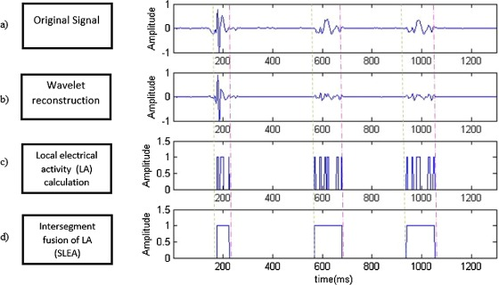
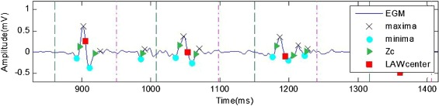
Features of EGM signals
Based on the concepts [1] of:
Local Activation Waves: portion of the signal centered on a peak of activation
Segments with Continuous local activity: portions of the signals where there’s a continue activation
Both definitions are based on DWT decomposition (mexihat) followed by reconstruction on 3 scales onto apply adaptive thresholds (similar to Pam-Tompkins one) are used to detect these portions of the signal. See Features evaluated appendix for the complete overview.
1. S. I. Duque, A. Orozco-Duque, V. Kremen, D. Novak, C. Tobón, e J. Bustamante, «Feature subset selection and classification of intracardiac electrograms during atrial fibrillation», Biomedical Signal Processing and Control, vol. 38, pp. 182–190, set. 2017

Slide 7
Literature review
More adherent
Less adherent
Feature extraction on EGM signals
S. I. Duque, A. Orozco-Duque, V. Kremen, D. Novak, C. Tobón, e J. Bustamante, «Feature subset selection and classification of intracardiac electrograms during atrial fibrillation», Biomedical Signal Processing and Control, vol. 38, pp. 182–190, set. 2017
Feature extraction on ECG easily usable on EGM
R. J. Martis, U. R. Acharya, e L. C. Min, «ECG beat classification using PCA, LDA, ICA and Discrete Wavelet Transform», Biomedical Signal Processing and Control, vol. 8, fasc. 5, pp. 437–448, set. 2013
Features are reduced representations of DWT decomposition of the signal
S. Tribhuvanam, H. C. Nagaraj, e V. P. S. Naidu, «ECG Abnormality Classification with Single Beat Analysis», in 2019 International Conference on Vision Towards Emerging Trends in Communication and Networking (ViTECoN), Vellore.
Features are statistical descriptors and amplitudes of fixed portions of the signal
Feature extraction on ECG signals hardly usable on EGM
P. deChazal, M. O’Dwyer, e R. B. Reilly, «Automatic Classification of Heartbeats Using ECG Morphology and Heartbeat Interval Features», IEEE Trans. Biomed. Eng., vol. 51, fasc. 7, pp. 1196–1206, lug. 2004.
Morphological features based on samples of the signal in fixed portions of it.
NB: Many other studies on ECG signals have been evaluated, but they fall, in terms of similarity of features used, into the first or second proposes.

Slide 8
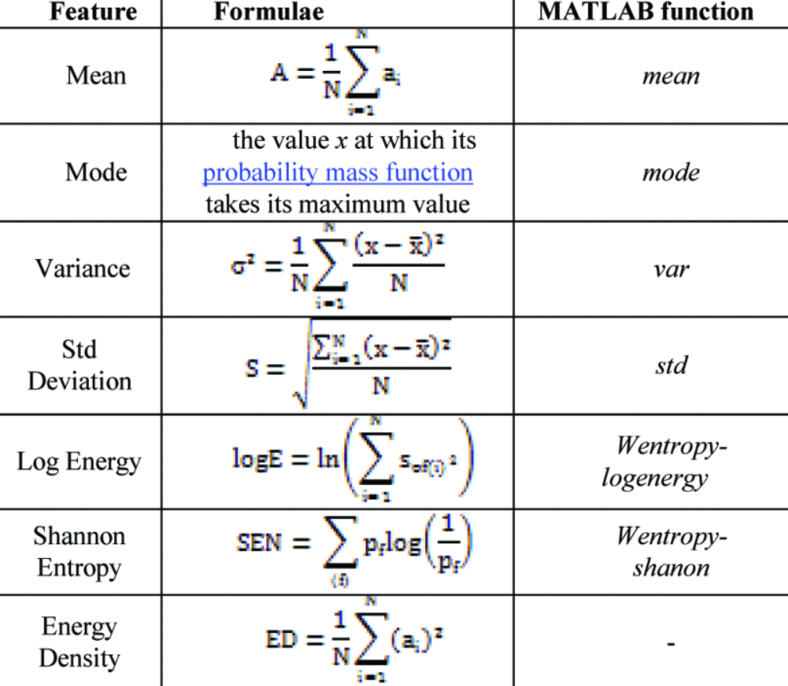
Features of ECG signals easily usable on EGM
The two proposed studies uses different set of features:
The first one [2] uses data dimensionality reduction on DWT decomposition of the signals.
First a 4 levels, dmey wavelet DWT transformation has been computed, then only the 4th level approximation and detail have been considered, as it has been shown that contain the expected discriminatory portion of the ECG signal. Then these two levels have been subjected independently to PCA, LCA or ICA to reduce their dimensionality. In total, 12 features have been computed.
The second one [3] uses statistical descriptors (table on the right) and fiducial points of the signals, heuristically found starting from the QRS (not shown)
2. R. J. Martis, U. R. Acharya, e L. C. Min, «ECG beat classification using PCA, LDA, ICA and Discrete Wavelet Transform», Biomedical Signal Processing and Control, vol. 8, fasc. 5, pp. 437–448, set. 2013
3. S. Tribhuvanam, H. C. Nagaraj, e V. P. S. Naidu, «ECG Abnormality Classification with Single Beat Analysis», in 2019 International Conference on Vision Towards Emerging Trends in Communication and Networking (ViTECoN), Vellore.

Slide 9
Literature review
More adherent
Less adherent
Feature extraction on EGM signals
S. I. Duque, A. Orozco-Duque, V. Kremen, D. Novak, C. Tobón, e J. Bustamante, «Feature subset selection and classification of intracardiac electrograms during atrial fibrillation», Biomedical Signal Processing and Control, vol. 38, pp. 182–190, set. 2017
Feature extraction on ECG easily usable on EGM
R. J. Martis, U. R. Acharya, e L. C. Min, «ECG beat classification using PCA, LDA, ICA and Discrete Wavelet Transform», Biomedical Signal Processing and Control, vol. 8, fasc. 5, pp. 437–448, set. 2013
Features are reduced representations of DWT decomposition of the signal
S. Tribhuvanam, H. C. Nagaraj, e V. P. S. Naidu, «ECG Abnormality Classification with Single Beat Analysis», in 2019 International Conference on Vision Towards Emerging Trends in Communication and Networking (ViTECoN), Vellore.
Features are statistical descriptors and amplitudes of fixed portions of the signal
Feature extraction on ECG signals hardly usable on EGM
P. deChazal, M. O’Dwyer, e R. B. Reilly, «Automatic Classification of Heartbeats Using ECG Morphology and Heartbeat Interval Features», IEEE Trans. Biomed. Eng., vol. 51, fasc. 7, pp. 1196–1206, lug. 2004.
Morphological features based on samples of the signal in fixed portions of it.
NB: Many other studies on ECG signals have been evaluated, but they fall, in terms of similarity of features used, into the first or second proposes.

Slide 10
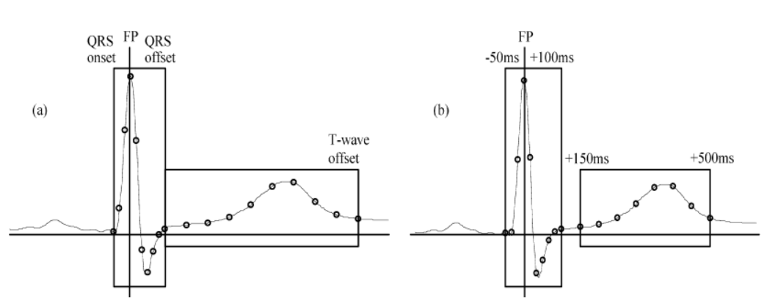
Features of ECG signals
The proposed study try to extrapolate morphological features from the original ECG signal by sub sampling:
Method A: subsampling of QRS and T-wave using fixed-position windows, positioned using the QRS position
Method B: subsampling of QRS and T-Wave using windows (fixed length) centered respect to the R peak and T peak
Points of the signals are used as features.
This method rely on too many assumptions (window length, window position) and could require normalization.
4. P. deChazal, M. O’Dwyer, e R. B. Reilly, «Automatic Classification of Heartbeats Using ECG Morphology and Heartbeat Interval Features», IEEE Trans. Biomed. Eng., vol. 51, fasc. 7, pp. 1196–1206, lug. 2004.

Slide 11
Outline
Literature review on feature extraction
Features from EGM signals
Features from ECG signals easily adaptable to EGM
Features from ECG signals hardly adaptable to EGM
Conclusions

Slide 12
Conclusions
Four articles have been quickly presented, while others have been evaluated to find out the best set of proposed features, at least from a theoretical point of view:
EGM features could all be evaluated and used. The choice of the best subset is remanded to the feature selection phase.
Dataset reduction methods are interesting but maybe hardly understandable from surgeons, thus their usage could be evaluated carefully
Statistical features could be evaluated but have many limitations which could be overcome by previous exposed methods. Moreover, peaks selection, made on fiducial segments of the signal, could be misleading and not robust.
Subsampling of signal segments has the same problem of the peak selection and in addition there could issues related to the frequency of subsampling. Finally, rely too much on hypothesis on the signal ad could require normalization.
Moreover, one could ask if there are other elements, present into the given database, that could be used as features. In my opinion positional information (x,y,z coordinates of the roving electrode), suitable referred to a common origin, could be informative.

